Slide 1
Constructing
the Machine Codes
for
8086 Instructions

Slide 2
Instruction Templates

Slide 3
Coding Template for
MOV
Instruction
(Moving Data between registers or between a register and a memory location)

Slide 4
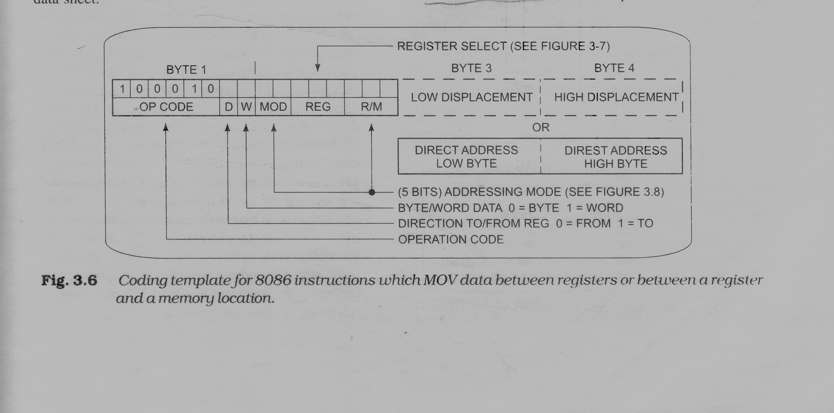

Slide 5
The upper 6 bits of the first byte are an opcode and for MOV it is 100010
The W bit in the first word is used to indicate whether a byte or a word is being moved
If you are moving a byte, make W=0 ; if you are moving a word, make W=1
If the instruction is moving data to the register identified in the REG field, make D=1
If the instruction is moving data from that register, make D=0

Slide 6
W=0
W=1
REGISTER | CODE
AL | 000
CL | 001
DL | 010
BL | 011
AH | 100
CH | 101
DH | 110
BH | 111
REGISTER | CODE
AX | 000
CX | 001
DX | 010
BX | 011
SP | 100
BP | 101
SI | 110
DI | 111

Slide 7
SEGMENT REGISTERS
SEGMENT REGISTER | CODE
CS | 01
DS | 11
ES | 00
SS | 10

Slide 8
mod | 00 | 01 | 10 | 11
R/M |  |  |  | W=0 W=1
000 | [BX]+[SI] | [BX]+[SI]+d8 | [BX]+[SI]+d16 | AL AX
001 | [BX]+[DI] | [BX]+[DI] +d8 | [BX]+[DI] +d16 | CL CX
010 | [BP]+[SI] | [BP]+[SI]+d8 | [BP]+[SI]+d16 | DL DX
011 | [BP]+[DI] | [BP]+[DI]+d8 | [BP]+[DI]+d16 | BL BX
100 | [SI] | [SI]+d8 | [SI]+d16 | AH SP
101 | [DI] | [DI]+d8 | [DI]+d16 | CH BP
110 | d16 (DIRECT ADDRESS) | [BP]+d8 | [BP]+d16 | DH SI
111 | [BX] | [BX]+d8 | [BX]+d16 | BH DI

Slide 9
MOV Instruction coding Examples

Slide 10
MOV SP, BX
Approach 1:
W = 1
D = 1 ( Moving data to the register specified by REG) and hence REG = 100
MOD ( for - from data i. e. BX) = 11
and corresponding R/M = 011
Final machine code: 1000101111100011
i. e. 8BE3

Slide 11
Approach 2:
W = 1
D = 0 ( Moving data from the register specified by REG) and hence REG = 011
MOD ( for - to data i. e. SP) = 11
and corresponding R/M = 100
Final Machine Code: 1000100111011100
i.e. 89DC

Slide 12
Assignments…
MOV CL, [BX]
MOV 43H[SI], DH
MOV CX, [437AH]

Slide 13
Instruction format for mov immediate
1100011w mod(2bits) 000 r/m(3bits) data data1(if w=1)
For mov ax, 1234h
11000111 11000000 34 12
C7C03412H

Slide 14
Instruction format for mov REGISTER TO SEGMENT REG
10001110 MOD(2bits) 0 SEGREG (2) R/M(3)
MOV DS, AX
Machine Code: 10001110 11011000
i. e. 8ED8h

Slide 15
Instruction format for mov SEGMENT REG TO REGISTER
10001100 MOD(2bits) 0 SEGREG (2) R/M(3)
MOV AX, DS
Machine code: 1000110011011000
i. e. 8CD8h

Slide 16
Writing Programs for use with an Assembler

Slide 17
SEGMENT AND ENDS DIRECTIVES
To put a group of data items or group of instructions in a particular segment
A group of data segments or a group of instruction statements contained between SEGMENT and ENDS directives is called a logical segment

Slide 18
Naming Data and Addresses – EQU, DB, DW and DD Directives
EQU Directive:
The EQU or equate directive is used to assign names to constants used in programs
Example:
NUM EQU 07H

Slide 19
Advantage of using EQU directive at start of programs is that if we want to modify the value of NUM it is enough if we change only at one place of declaration; it will reflect at all occurrences of NUM in the pgm

Slide 20
DB, DW and DD Directives
DB takes 1 byte of memory location
Examples:
A DB 12H
Array DB 27H, 48H, 32H, 69H
C DB ?
? Signifies we don’t care about the initial value

Slide 21
DW (Word) takes 2 byte of memory location
DD (Double Word) takes 4 bytes of memory location
Note: Refer Example Program multiply.asm

Slide 22
Multiply.asm
Data segment
a dw 204Ah
b dw 3B2Ah
c dw 2 dup (0)
Data ends
Code segment
assume cs:code, ds:data
Start: mov ax, data
mov ds, ax
mov ax, a
mul b
mov c, ax
mov c+2, dx
mov ah, 4ch
int 21h
Code ends
End start

Slide 23
Types of Numbers in Data Statements
BINARY:
Example:
MAX DB 01111001B
If you want to put in a negative binary no, write the no in its 2’s complement sign-and-magnitude form

Slide 24
DECIMAL:
Example:
MAX DB 49
If you specify a –ve no in a data declaration statement, the assembler will convert it to 2’s complement form
Example:
MIN DB -20

Slide 25
HEXADECIMAL:
A hexadecimal number is indicated by an H after the hexadecimal digits
Example:
NUM1 DB 35H
Note:
A zero must be placed in front of a hex number that starts with a letter
Example:
NUM2 DB 0F4H

Slide 26
BCD: (Binary Coded Decimal)
BCD uses a 4-bit binary code to individually represent each decimal digit in a number
Uses the first 10 numbers of a standard binary code for the BCD numbers 0 through 9
The hex codes A through F are invalid BCD codes

Slide 27
To convert a decimal number to its BCD equivalent, just represent each decimal digit by its 4-bit binary equivalent
Decimal 5 2 9
BCD 0101 0010 1001
To convert a BCD number to its decimal equivalent, reverse the process

Slide 28
BCD Addition:
1)
BCD
35 0011 0101
+23 + 0010 0011
58 0101 1000

Slide 29
2)
BCD
7 0111
+5 + 0101
12 1100 Incorrect BCD
+ 0110 Add 6
0001 0010 correct BCD 12

Slide 30
3)
BCD
9 1001
+ 8 + 1000
17 0001 0001 Incorrect BCD
0000 0110 Add 6
0001 0111 correct BCD 17

Slide 31
Note:
The reason for the correction factor 6 is that in BCD we want a carry into the next digit after 1001 or 9, but in binary a carryout of the lower 4 bits doesn’t occur until after 1111 or 15.
The difference between the two carry points is to produce the desired carry if the result of an addition in any BCD is more than 1001

Slide 32
If you want the assembler to initialize a variable with the value 37 BCD, we have to put an H after the number
Example:
SECONDS DB 59H
This will initialize SECONDS with 0101 1001, which is BCD representation of 59

Slide 33
ASCII:
We can declare a data structure (array) containing a sequence of ASCII codes by enclosing the letters or numbers after a DB in single quotation marks
Example:
BOY1 DB ‘RAM’
Tells the assembler to declare a data item named BOY1 that has 3 memory locations

Slide 34
It also tells the assembler to put the ASCII code for R in the first memory location, ASCII code for A in second memory location and ASCII code for M in 3rd memory location
The assembler will automatically determine the ASCII codes for the letters or numbers within the quotes

Slide 35
Accessing Named Data with program instructions
The assembler will automatically calculate the displacement of the named data item from the start of the segment and insert this value as part of the binary code for the instruction
Example:
a dw 1234h
b db 23h

Slide 36
Naming Addresses - Labels
One type of name used to represent addresses is called a label
Labels are written in the label field of an instruction statement or a directive statement
One major use of labels is to represent the destination for jump and call instructions

Slide 37
Example:
NEXT : IN AL, 05H
.
.
.
JMP NEXT

Slide 38
The ASSUME Directive
At any given time the 8086 works directly with only four physical segments: a code segment, a data segment, a stack segment and an extra segment
The ASSUME directive tells the assembler which logical segment to use for each of these physical segments at a given time

Slide 39
For example, the statement
ASSUME CS:CODE, DS:DATA tells the assembler that the logical segment named CODE contains the instruction statements for the program and should be treated as a code segment
It also tells the assembler that it should treat the logical segment DATA as data segment

Slide 40
If we are using stack segment and extra segment in our program we need to include it in ASSUME directive
Example:
SS : STACK and ES : EXTRA

Slide 41
Initializing Segment Registers
When the instructions are executed, the displacements in the instructions will be added to the segment base addresses represented by the 16-bit numbers in the segment registers to produce the actual physical addresses

Slide 42
The segment registers other than the code segment register must be initialized by program instructions before they can be used to access data
If data segment represented by DATA then the instructions for this are:
MOV AX, DATA
MOV DS, AX

Slide 43
If we use the stack segment and the extra segment in a program, the stack segment register and the extra segment register must be initialized by program instructions in the same way

Slide 44
The END Directive
Tells the assembler to stop reading the assembly language code
Any instructions or statements that we write after an END directive will be ignored

Slide 45
Assembly Language Program Development Tools
We will probably want to use some type of program development tools to make our work easier
Most of these tools are programs which we run to perform some function on the program we are writing

Slide 46
Editor
Is a program which allows us to create a file containing the assembly language statements for our program
As we type in our program, the editor stores the ASCII codes for the letters and numbers in successive RAM locations

Slide 47
When we have typed in all our program, we then save the file on hard disk
If we are going to use MASM assembler, we should give the source file name the extension .asm

Slide 48
Assembler
Translates the assembly language mnemonics for instructions to the corresponding binary codes
On the first pass through the source program, the assembler determines the displacement of named data items, the offset of labels etc and puts this information in a symbol table

Slide 49
On the second pass through the source program, the assembler produces the binary code for each instruction and inserts the offsets, etc that is calculated during first pass
The assembler generates two files on hard disk
The .obj file and .lst file

Slide 50
The .obj file i.e. object file contains the binary codes for the instructions and information about the addresses of the instructions
The .lst i.e. assembler list file consists of assembly language statements, the binary codes for each instruction and the offset for each instruction

Slide 51
The assembler listing will also indicate any typing or syntax errors we made in our source program

Slide 52
Linker
A linker is a program used to join several object files into one large object file
When writing large programs, it is usually much efficient to divide the large program into smaller modules
Each module can be individually written, tested and debugged

Slide 53
When all the modules work, their object modules can be linked together to form a large, functioning program
The linker produces a link file which contains the binary codes for all the combined modules
The linker also produces a link map file which contains the address information about the linked files

Slide 54
The MASM assemblers produce link files with the .EXE extension

Slide 55
Locator
A locator is a program used to assign the specific addresses of where the segments of object code are to be loaded into memory

Slide 56
Debugger
A debugger is a program which allows you to load our object code program into system memory, execute the program and troubleshoot or debug it
Allows us to look at the contents of registers and memory locations after our program runs

Slide 57
A debugger also allows us to set a breakpoint at any point in our program
If we insert a breakpoint, the debugger will run the program up to the instruction where we put the breakpoint and then stop execution
The debugger commands help us to quickly find the source of a problem in our program

Slide 58
Emulator
Is a mixture of hardware and software
Is usually used to test and debug the hardware and software of an external system, such as the prototype of a microprocessor-based instrument

Slide 59
Like a debugger, an emulator allows us to load and run programs, examine and change the contents of registers, examine and change the contents of memory locations and insert breakpoints in the program
The emulator also takes a snapshot of the contents of the registers, activity on the address and data bus, and the state of the flags as each instruction executes

Slide 60
Thank You..

